Slide 1
Transactions

Slide 2
Transaction Scope
TransactionScope is a very special and important class in the .NET Framework. Supporting transactions from a code block is the main responsibility of this class. We often use this class for managing local as well as distributed transactions from our code. Use of TransactionScope is very simple and straightforward. It is very reliable and easy to use. For this reason it is very popular among .NET developers.

Slide 3
Business Transaction
Business transactions are interactions between Customer/Supplier/StakeHolders and other parties who are involved in doing business.
Database Transaction
In software development, when we say transaction by default we guess that it is a database transaction. In a database transaction we can say, a series of data manipulation statements (insert/update/delete) execute as a whole. All statements either successfully execute, or will fail each and every statement, so that the database is in consistent mode. Database transactions actually represent a database state change in an accurate way.

Slide 4
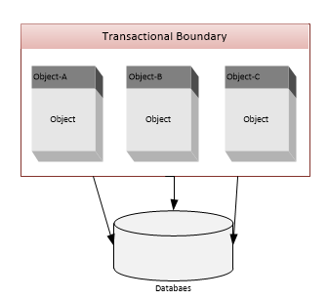
Local Transaction
A transaction where a series of data manipulation statements execute as a whole on a single data source/database. It is actually a single phase transaction handled by a database directly. To manage local transactions, System.Transactions has a Lightweight Transaction Manager (LTM). It acts like a gateway. All transactions are started by System.Transactions are handled directly by this component. If it finds the transaction nature is distributed based on some predefined rules it has a fallback transaction to the MSDTC distributed transaction.

Slide 5
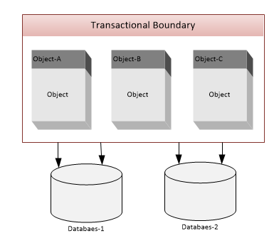
Distributed Transactions
A transaction which works with multiple data sources is called a distributed transaction. If a transaction fails then the affected data sources will be rolled back. In System.Transactions, MSDTC (Microsoft Distributed Transaction Coordinator) manages distributed transactions. It implements a two phase commit protocol. A distributed transaction is much slower than a local transaction. The transaction object automatically escalates a local transaction to a distributed transaction when it understands that a distributed transaction is needed. The developer can not do anything here.

Slide 6
Transaction Properties
There are four important properties for a transaction. We call them ACID properties. They are:
A-Atomic
C-Consistent
I-Isolation
D-Durable
Atomic: If all parts of the transaction individually succeed then data will be committed and the database will be changed. If any single part of a transaction fails then all parts of the transaction will fail and the database will remain unchanged. Part of the transaction might fail for various reasons like business rule violation, power failure, system crash, hardware failure, etc.
Consistent: Transaction will change the database from one valid state to another valid state following various database rules like various data integrity constraints (primary/unique key, check/not null constraint, referential integrity with valid reference, cascading rules ) etc.
Isolation: One transaction will be hidden from another transaction. In another way we can say, one a transaction will not affect another transaction if both work concurrently.
Durability: After a transaction is successfully completed (committed to the database), changed data will not be lost in any situation like system failure, database crash, hardware failure, power failure etc.

Slide 7
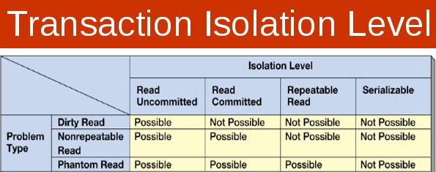
Serializable: Highest level of isolation. It locks data exclusively when read and write occurs. It acquires range locks.
Repeatable Read: Second highest level of isolation. Same as serializable except it does not acquire range locks.
Read Committed: It allow shared locks and read, only committed data. That means never read changed data that are in the middle of any transaction.
Read Un-Committed: It is the lowest level of Isolation. It allows dirty read

